Slide 1

Note: The data and information in this document is reflective of a hypothetical situation and client. This document is to be used for KPMG Virtual Internship purposes only.
Sprocket Central Pty Ltd
Data analytics approach
KPMG- Virtual internship- Sruthi E R

Slide 2
Note: The data and information in this document is reflective of a hypothetical situation and client. This document is to be used for KPMG Virtual Internship purposes only.
Agenda
Introduction
Data Exploration
Model Development
Interpretation

Slide 3
Note: The data and information in this document is reflective of a hypothetical situation and client. This document is to be used for KPMG Virtual Internship purposes only.
Introduction
Identify & Recommending High Value Customers
Outline of Problem
Sprocket Central is a company that specializes in high quality bike and accessories.
The Marketing Team is looking to boost sales.
To target its new customers that will bring the highest value to the business.
.
Approach for Data Analysis
Bike Related Purchases for last 3 years based on Gender & Age Group.
Top Industries contributing the maximum profit and bike related sales.
Wealth Segment by Age Category.
Number of Cars owned in each state ,bike purchase & profit.
Customer Classification.

Slide 4
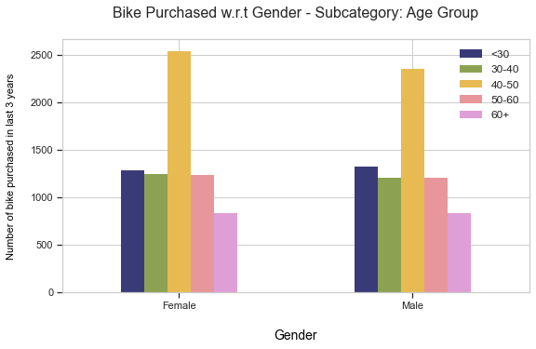
Note: The data and information in this document is reflective of a hypothetical situation and client. This document is to be used for KPMG Virtual Internship purposes only.
Interpretation
Bike Related Purchased in last 3 years based on Gender ; Sub Categorise – Age Group.
Graph shows age group of 40-50 shows highest purchase in last three years.
Female has highest proportions when compared to males.
Place any supporting images, graphs, data or extra text here.

Slide 5
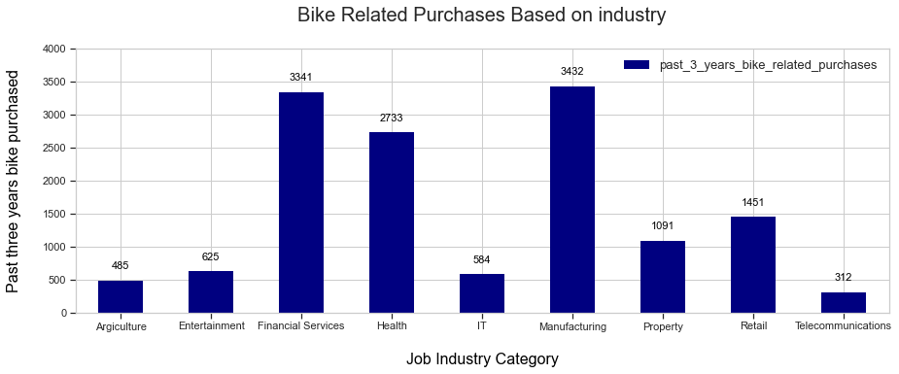
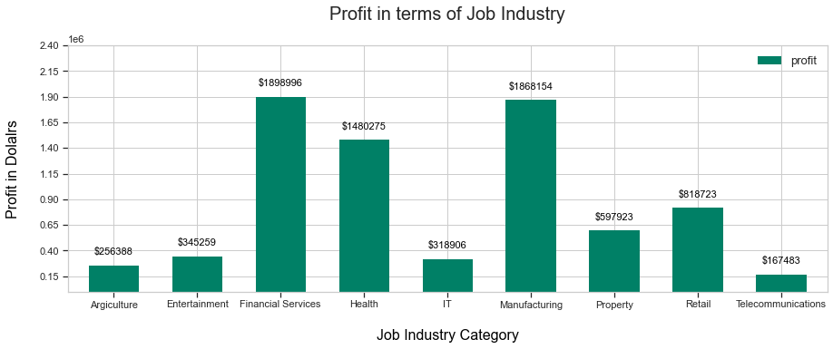
Note: The data and information in this document is reflective of a hypothetical situation and client. This document is to be used for KPMG Virtual Internship purposes only.
Interpretation
Top Job Industry Contributing to Maximum Profit & Bike Purchased
1. Industry like Manufacturing Financial Services and Health holds high profit. 2. Most of the industry sectors have returned less than $ 1,000,000 in profits 3. Industry like - Manufacturing & Financial Services holds a high record in terms of bike purchased in last 3 years.

Slide 6
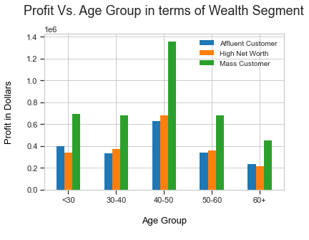
Note: The data and information in this document is reflective of a hypothetical situation and client. This document is to be used for KPMG Virtual Internship purposes only.
Interpretation
Profit of Wealth Segment w.r.t Age Group
Wealth segment of mass customer gives high amount of profit in different age groups.
The age group that gives high profit is 40-50.
This also indicates a trend of buying power, as the buying power increases over time till 50 and then see’s a decline in buying power, thus leading to lower profits.
Place any supporting images, graphs, data or extra text here.

Slide 7
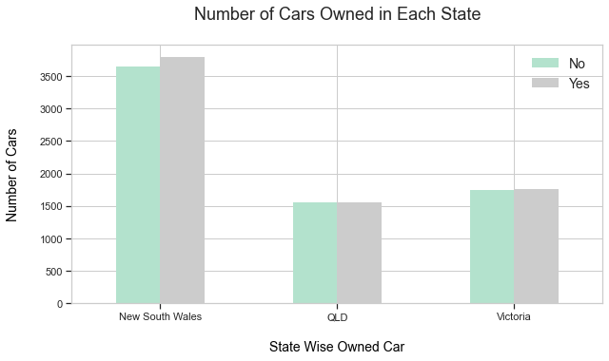
Note: The data and information in this document is reflective of a hypothetical situation and client. This document is to be used for KPMG Virtual Internship purposes only.
Interpretation
Number of Cars Owned in Each State
Out of three states, New South Wales, could be potential market opportunities for the company.
The New South Wales has the highest potential as the number of people that own car is almost equal to the people who don’t own cars which shows that there is opportunity to find value customers there.
Place any supporting images, graphs, data or extra text here.

Slide 8
Note: The data and information in this document is reflective of a hypothetical situation and client. This document is to be used for KPMG Virtual Internship purposes only.
Model Development
Customer classification & targeting high value customer
Target customer
Who are currently living in New South Wales and Victoria.
Aged between 40 – 50.
Working in Financial Service, Manufacturing and Health.
Most of the high value customers are female compared to male.

Slide 9
Note: The data and information in this document is reflective of a hypothetical situation and client. This document is to be used for KPMG Virtual Internship purposes only.
Model Development
Targeted marketing strategies using RFM-analysis
RFM-analysis is a scoring method focusing on the following three parameters:
Recency (R) of a customer: Days since the last purchase.
Frequency (F) : Number of purchases, e.g., in 12 months.
Monetary (M) - The total turnover of a customer: Sum of sales, e.g., in 12 months.

Slide 10
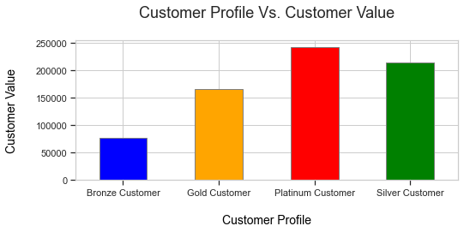
Note: The data and information in this document is reflective of a hypothetical situation and client. This document is to be used for KPMG Virtual Internship purposes only.
Interpretation
Customer profile versus customer value based on RFM analysis
The Platinum Customers holds high value as they have RFM value.
The company should go for Platinum Customers them because, they hold higher customer value compared to all the other customers.
Place any supporting images, graphs, data or extra text here.

Slide 11
Note: The data and information in this document is reflective of a hypothetical situation and client. This document is to be used for KPMG Virtual Internship purposes only.
THANK YOU

